Slide 1



Speech Recognition for Edge Devices
University of Chicago MScA Capstone
December 3, 2022
Team:
Dylaan Cornish
Henry Fernandez
Joey Tomal
Notes:
--- when you hear what we have to say to you you might never want to use your alexa again!!! :O

Slide 2

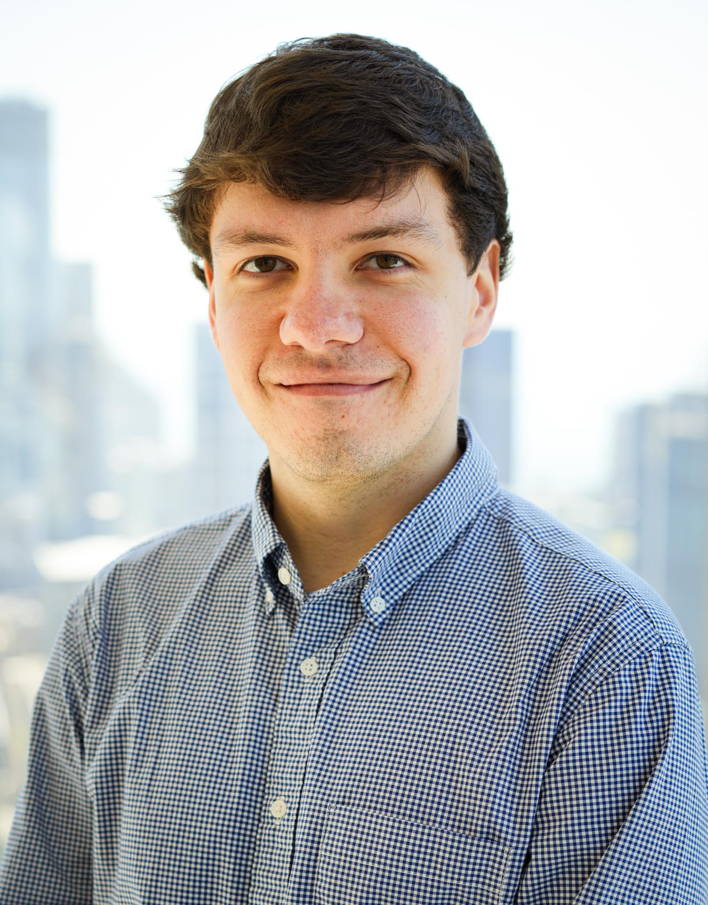
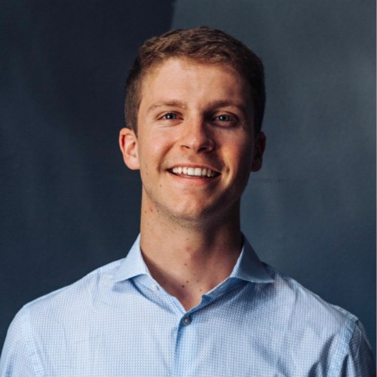
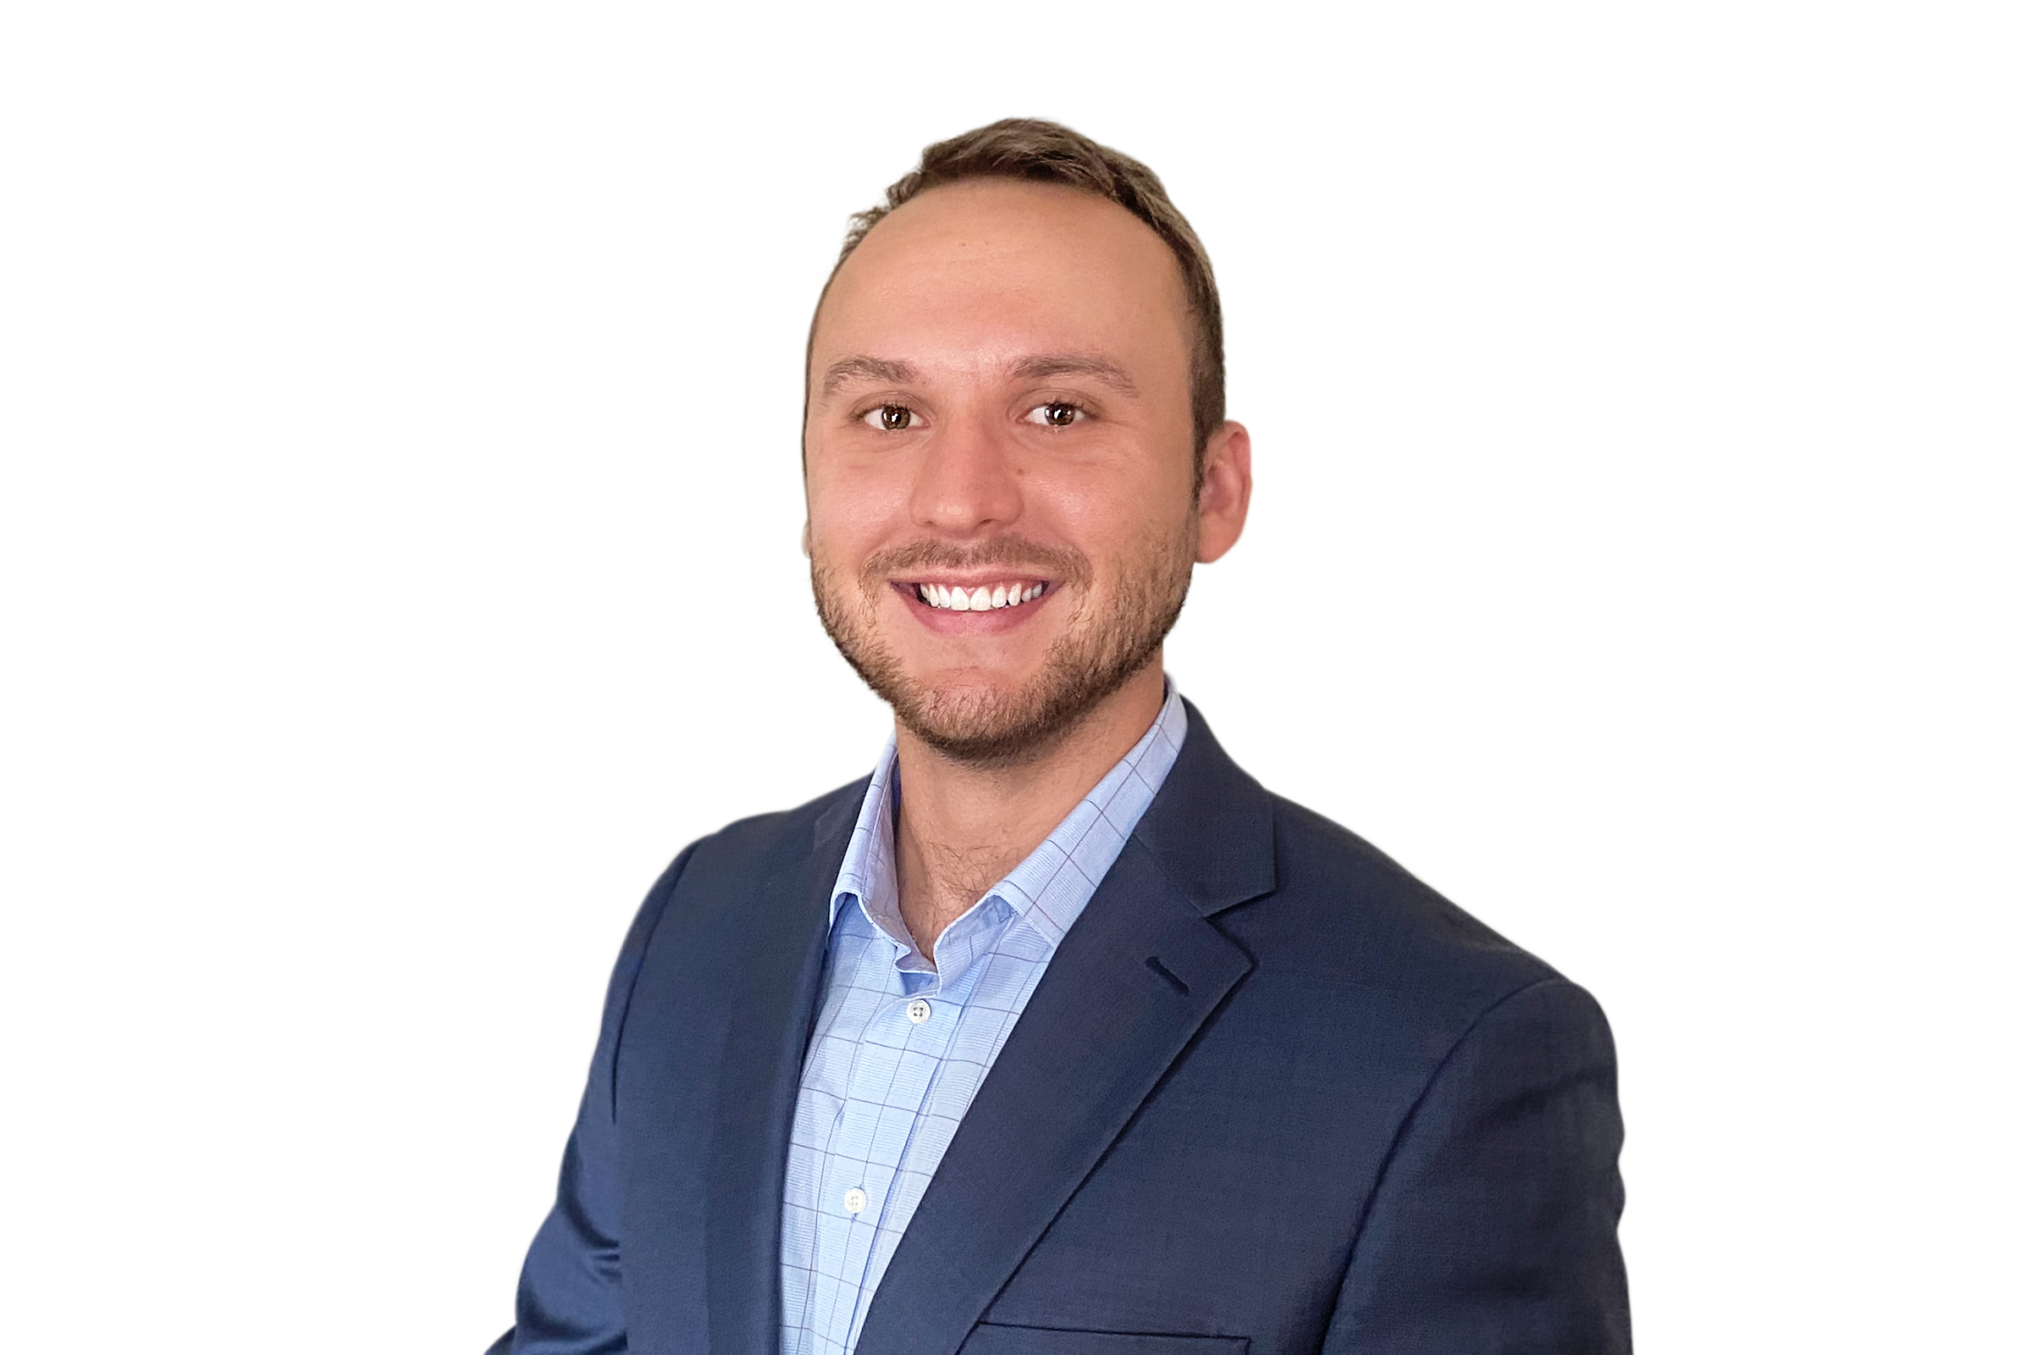


Team Maxim Integrated
Dylaan Cornish​
Henry Fernandez
Joey Tomal

Slide 3
Agenda
Opportunity
Resources
Methodology
Demo and Conclusion

Slide 4

.
Maxim Integrated designs, manufactures, and sells analog and mixed signal integrated circuits for numerous industries.
Notes:
Founded in 1983 by 9 Pioneers of the semi-conductor industry,

Slide 5

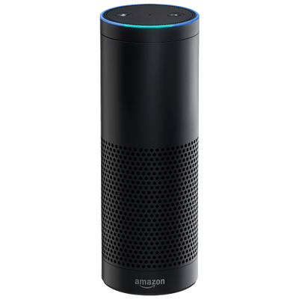
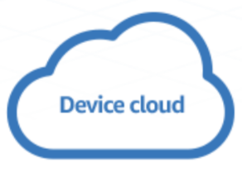

Opportunity Resources Methodology Demo & Conclusion​
Your private conversations aren't private.
5
Notes:
**potentially spell this out more. How WHENVER YOU speak it’s uploaded to the interent**
Alexa, siri, cortana, or any smart speaker already does that. You can ask it anything imaginable and it has a response. And you’re right, it does.
But the way that these smart devices work is: *display diagram above* they upload your voice audio to cloud servers and perform the speech recognition. They are always listening. (examples of this, dylaans link, amazon storing link). The benefit of this is that it’s very powerful, but the cons are that, whaterver company manufactured that device now has your vocal data and it’s being uploaded to the internet. There are natural privacy concerns with this, and there. And Sending audio to the cloud also means increased latency, which is not ideal for a variety of edge devices.
So for privacy it would be huge for people to have pretrained words on these edge devices. And have an Edge device will not send your voice to other places

Slide 6


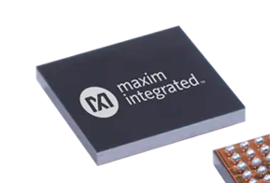
Opportunity Resources Methodology Demo & Conclusion​
…but they should be.
6
Notes:
This is where the Max78000 comes into the picture. Maxim integrated is looking to cut the internet aspect out of the equationand perform the key word spotting securely and entirely locally onto the chip. This is where we were called into to build the most efficient solution possible for this speech recognition process.
Our energy efficient chip could be used on literally any edge device. And the big benefits of having a speech regonition system on this chip is that
1. Energy consumption is greatly improved (you can keep key word spotter always on), so this keyword spotter can be on for way way longer. Good for hearing aids or devices
2. Maximum Privacy (not internet or cloud involved)
3. No Latency issues (see above)
4. Much more Cost effective. (see below)]

Slide 7
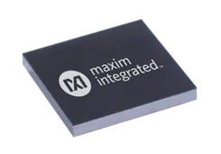
Opportunity Resources Methodology Demo & Conclusion​
However, the mainstream method of speech recognition will not work when deployed locally on the chip.
Speech Recognition for Edge Devices
7
Notes:
HOWEVER, WHEN IT'S LOCALIZED ON THIS CHIP, YOU CAN'T USE THE SAME METHODS THAT ARE USED TODAY BECAUSE THEY ARE SO INEFFICIENT.". "So they made this cool chip but now there's a big problem. *don't use this microchip image*. And that's the issue we are going to solve.
**what does INEFFICIENT MEAN (“and now I’m gonna explain in more detail”
Before we go further into this problem. It’s important to understand one of the major steps in speech recognition as well as what MFCCs are
first we will walk you through what happens today with current processes”…

Slide 8
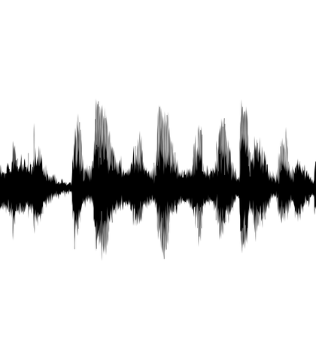
Opportunity Resources Methodology Demo & Conclusion​
Breaking down current speech recognition process
Audio
8
Notes:
“first we will walk you through what happens today with current processes”…
Before we go further into this problem. It’s important to understand one of the major steps in speech recognition as well as what MFCCs are. Currently, the industry standard for step 1, which is labeled with the red box, is to take an audio input, and compute a series of computationally expensive calculations using fourier transforms and others. This is to produce an MFCC, or mel frequency cepstral coefficient. The reason MFCCs are used is becaused machines can interpret tabular data like an MFCC much better than they can with waveform audio. So these MFCCs which you will see a few times, are fantastic features for ML algorithms to learn words and phonemes with. however it is BAD for computation efficiencies and can’t fit on the Max78000. And this is the specific portion of the process we are looking to replace so that it fits on the chip.
“say this, this is how it’s done today…
“provide a reminder… we can’t solve the privacy problem by recreating this process that is currently used…. So we need a new one”
**what does computationally expensive mean??** -- elaborate / clarify.
-

Slide 9
Opportunity Resources Methodology Demo & Conclusion​
Breaking down current speech recognition process
Industry Standard
Complex Calculations
Audio
9
Notes:
“first we will walk you through what happens today”…
Before we go further into this problem. It’s important to understand one of the major steps in speech recognition as well as what MFCCs are. Currently, the industry standard for step 1, which is labeled with the red box, is to take an audio input, and compute a series of computationally expensive calculations using fourier transforms and others. This is to produce an MFCC, or mel frequency cepstral coefficient. The reason MFCCs are used is becaused machines can interpret tabular data like an MFCC much better than they can with waveform audio. So these MFCCs which you will see a few times, are fantastic features for ML algorithms to learn words and phonemes with. however it is BAD for computation efficiencies and can’t fit on the Max78000. And this is the specific portion of the process we are looking to replace so that it fits on the chip.
“say this, this is how it’s done today…
“provide a reminder… we can’t solve the privacy problem by recreating this process that is currently used…. So we need a new one”
**what does computationally expensive mean??** -- elaborate / clarify.
-

Slide 10
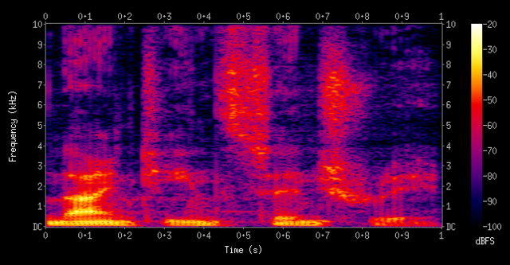
Opportunity Resources Methodology Demo & Conclusion​
Breaking down current speech recognition process
Industry Standard
Complex Calculations
Audio
MFCC
10
Notes:
“first we will walk you through what happens today”…
Before we go further into this problem. It’s important to understand one of the major steps in speech recognition as well as what MFCCs are. Currently, the industry standard for step 1, which is labeled with the red box, is to take an audio input, and compute a series of computationally expensive calculations using fourier transforms and others. This is to produce an MFCC, or mel frequency cepstral coefficient. The reason MFCCs are used is becaused machines can interpret tabular data like an MFCC much better than they can with waveform audio. So these MFCCs which you will see a few times, are fantastic features for ML algorithms to learn words and phonemes with. however it is BAD for computation efficiencies and can’t fit on the Max78000. And this is the specific portion of the process we are looking to replace so that it fits on the chip.
“say this, this is how it’s done today…
“provide a reminder… we can’t solve the privacy problem by recreating this process that is currently used…. So we need a new one”
**what does computationally expensive mean??** -- elaborate / clarify.
-

Slide 11
Opportunity Resources Methodology Demo & Conclusion​
Breaking down current speech recognition process
Industry Standard
Complex Calculations
Audio
MFCC
11
Notes:
“first we will walk you through what happens today”…
Before we go further into this problem. It’s important to understand one of the major steps in speech recognition as well as what MFCCs are. Currently, the industry standard for step 1, which is labeled with the red box, is to take an audio input, and compute a series of computationally expensive calculations using fourier transforms and others. This is to produce an MFCC, or mel frequency cepstral coefficient. The reason MFCCs are used is becaused machines can interpret tabular data like an MFCC much better than they can with waveform audio. So these MFCCs which you will see a few times, are fantastic features for ML algorithms to learn words and phonemes with. however it is BAD for computation efficiencies and can’t fit on the Max78000. And this is the specific portion of the process we are looking to replace so that it fits on the chip.
“say this, this is how it’s done today…
“provide a reminder… we can’t solve the privacy problem by recreating this process that is currently used…. So we need a new one”
**what does computationally expensive mean??** -- elaborate / clarify.
-

Slide 12
Opportunity Resources Methodology Demo & Conclusion​
Breaking down current speech recognition process
Industry Standard
Complex Calculations
Audio
MFCC
ML Algorithm
12
Notes:
“first we will walk you through what happens today”…
Before we go further into this problem. It’s important to understand one of the major steps in speech recognition as well as what MFCCs are. Currently, the industry standard for step 1, which is labeled with the red box, is to take an audio input, and compute a series of computationally expensive calculations using fourier transforms and others. This is to produce an MFCC, or mel frequency cepstral coefficient. The reason MFCCs are used is becaused machines can interpret tabular data like an MFCC much better than they can with waveform audio. So these MFCCs which you will see a few times, are fantastic features for ML algorithms to learn words and phonemes with. however it is BAD for computation efficiencies and can’t fit on the Max78000. And this is the specific portion of the process we are looking to replace so that it fits on the chip.
“say this, this is how it’s done today…
“provide a reminder… we can’t solve the privacy problem by recreating this process that is currently used…. So we need a new one”
**what does computationally expensive mean??** -- elaborate / clarify.
-

Slide 13

Opportunity Resources Methodology Demo & Conclusion​
Breaking down current speech recognition process
Industry Standard
Complex Calculations
Audio
MFCC
ML Algorithm
"Backward"
13
Notes:
“first we will walk you through what happens today”…
Before we go further into this problem. It’s important to understand one of the major steps in speech recognition as well as what MFCCs are. Currently, the industry standard for step 1, which is labeled with the red box, is to take an audio input, and compute a series of computationally expensive calculations using fourier transforms and others. This is to produce an MFCC, or mel frequency cepstral coefficient. The reason MFCCs are used is becaused machines can interpret tabular data like an MFCC much better than they can with waveform audio. So these MFCCs which you will see a few times, are fantastic features for ML algorithms to learn words and phonemes with. however it is BAD for computation efficiencies and can’t fit on the Max78000. And this is the specific portion of the process we are looking to replace so that it fits on the chip.
“say this, this is how it’s done today…
“provide a reminder… we can’t solve the privacy problem by recreating this process that is currently used…. So we need a new one”
**what does computationally expensive mean??** -- elaborate / clarify.
-

Slide 14
Opportunity Resources Methodology Demo & Conclusion​
Audio Features (MFCCs) are too computationally expensive for MAX78000
Industry Standard
Complex Calculations
Audio
MFCC
ML Algorithm
"Backward"
14
Notes:
“first we will walk you through what happens today”…
Before we go further into this problem. It’s important to understand one of the major steps in speech recognition as well as what MFCCs are. Currently, the industry standard for step 1, which is labeled with the red box, is to take an audio input, and compute a series of computationally expensive calculations using fourier transforms and others. This is to produce an MFCC, or mel frequency cepstral coefficient. The reason MFCCs are used is becaused machines can interpret tabular data like an MFCC much better than they can with waveform audio. So these MFCCs which you will see a few times, are fantastic features for ML algorithms to learn words and phonemes with. however it is BAD for computation efficiencies and can’t fit on the Max78000. And this is the specific portion of the process we are looking to replace so that it fits on the chip.
“say this, this is how it’s done today…
“provide a reminder… we can’t solve the privacy problem by recreating this process that is currently used…. So we need a new one”
**what does computationally expensive mean??** -- elaborate / clarify.
-

Slide 15
Opportunity Resources Methodology Demo & Conclusion​
Audio Features (MFCCs) are too computationally expensive for MAX78000
Our Efficient Machine Learning Solution
Estimated MFCC
Audio
ML Algorithm
"Backward"
15
Notes:
***green box here
*replace these icons with transition for next slid**
So as seen in this diagram, instead of performing these calculations we come up with an efficient ML solution that we will discuss later. So the challenge is 1.) find a way to get these audio features WITHOUT using the set of calculations that are currently being used and 2.) make this new, highly efficient method of speech recognition still work as accurately is industry leading products.
The reason the industry standard recognition won’t fit onto the MAX78K is due to a series of complex calculations that turns the input audio into Machine interpretable audio features like a spectrogram.
There are 2 major parts for speech recognition. But the first part is where these computationally heavy transformations take place, and is what our solution is looking to replace. The 2nd part of the process remains the same.

Slide 16
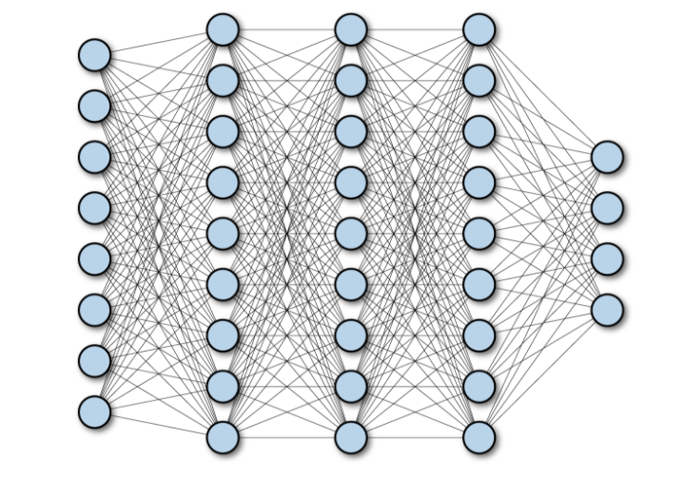
Opportunity Resources Methodology Demo & Conclusion​
Audio Features (MFCCs) are too computationally expensive for MAX78000
Fully-connected
Neural Network
Estimated MFCC
Audio
ML Algorithm
"Backward"
16
Notes:
***green box here
*replace these icons with transition for next slid**
So as seen in this diagram, instead of performing these calculations we come up with an efficient ML solution that we will discuss later. So the challenge is 1.) find a way to get these audio features WITHOUT using the set of calculations that are currently being used and 2.) make this new, highly efficient method of speech recognition still work as accurately is industry leading products.
The reason the industry standard recognition won’t fit onto the MAX78K is due to a series of complex calculations that turns the input audio into Machine interpretable audio features like a spectrogram.
There are 2 major parts for speech recognition. But the first part is where these computationally heavy transformations take place, and is what our solution is looking to replace. The 2nd part of the process remains the same.

Slide 17
Opportunity Resources Methodology Demo & Conclusion​
Audio Features (MFCCs) are too computationally expensive for MAX78000
Fully-connected
Neural Network
Estimated MFCC
Audio
ML Algorithm
"Backward"
17
Notes:
***green box here
*replace these icons with transition for next slid**
So as seen in this diagram, instead of performing these calculations we come up with an efficient ML solution that we will discuss later. So the challenge is 1.) find a way to get these audio features WITHOUT using the set of calculations that are currently being used and 2.) make this new, highly efficient method of speech recognition still work as accurately is industry leading products.
The reason the industry standard recognition won’t fit onto the MAX78K is due to a series of complex calculations that turns the input audio into Machine interpretable audio features like a spectrogram.
There are 2 major parts for speech recognition. But the first part is where these computationally heavy transformations take place, and is what our solution is looking to replace. The 2nd part of the process remains the same.

Slide 18
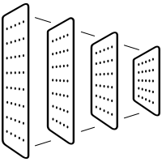
Opportunity Resources Methodology Demo & Conclusion​
Audio Features (MFCCs) are too computationally expensive for MAX78000
Fully-connected
Neural Network
Convolutional Neutral Network
Estimated MFCC
Audio
"Backward"
18
Notes:
**this is problem we solved, but the solution requires another piece… then explain convolution neural network and say how this is pretty standard and used regulary
And we were able to find a solution for this. Using this framework, which we will dive into later,. we achieved 92% accuracy on a set of 20 words and a 15 word rejection class.

Slide 19
Opportunity Resources Methodology Demo & Conclusion​
We have achieved 92% accuracy on 20 words and a rejection class
19
Notes:
And we were able to find a solution for this. Using this framework, which we will dive into later,. we achieved 92% accuracy on a set of 20 words and a 15 word rejection class.

Slide 20
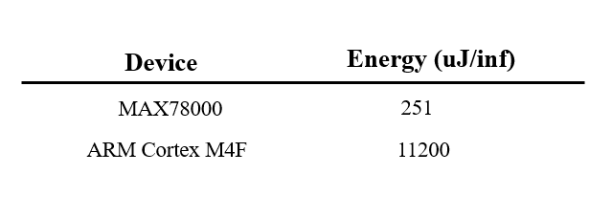
Opportunity Resources Methodology Demo & Conclusion​
MAX78000 is over 44x more energy efficient than the state-of-the-art
20
Notes:
In fact, our solution is 44x more energy efficient than the state of the art And has 258x less latency than the ARM Cortex m4F, which is currently being marketed as a “ highly-efficient embedded processor”.
--- /inf
--- say that this is the benchmark given to us by Maxim integrated ( need to know more about this ARM Cortex)
----this is a big benefit if it can be solved because it’s SO efficient.
---- get rid of latency
Look more into ARM Cortex m4F. Confusion here: we go from comparing cloud based industry standard feature and now we’re comparing two microchip. What happened to comparing to cloud based process. Maybe in this table, compare MAX against other process.

Slide 21


Opportunity Resources Methodology Demo & Conclusion​
We use industry standard data to train our model
Samples | 77,000
Duration | 1 Second
Words | 35
21
Notes:
Say why it’s 35 words.

Slide 22


Opportunity Resources Methodology Demo & Conclusion​
Paired with industry standard tools
22
Notes:
Trained and Hyperparameter Tuned each model in sequence of increasing word counts
Classification architecture was decided but needed tuning

Slide 23

Opportunity Data Sources Methodology Summary & Results​
What types of models can accurately estimate MFCCs?
Estimated
MFCC
Audio Input
23
Notes:
Explain here, so instead of outright calculating the mfcc for each word which is very slow, we trained a Fully connected neural network to estimate them – which is significantly more significant while also preserving accuracy.
Then once we have these MFCCs we move on to the the word classification, but that is a much simpler problem and one that has been solved.

Slide 24
Opportunity Data Sources Methodology Summary & Results​
We experimented with three deep learning models
Fully Connected Neural Network (FCNN)
24
Notes:
Explain here, so instead of outright calculating the mfcc for each word which is very slow, we trained a Fully connected neural network to estimate them – which is significantly more significant while also preserving accuracy.
Then once we have these MFCCs we move on to the the word classification, but that is a much simpler problem and one that has been solved.

Slide 25
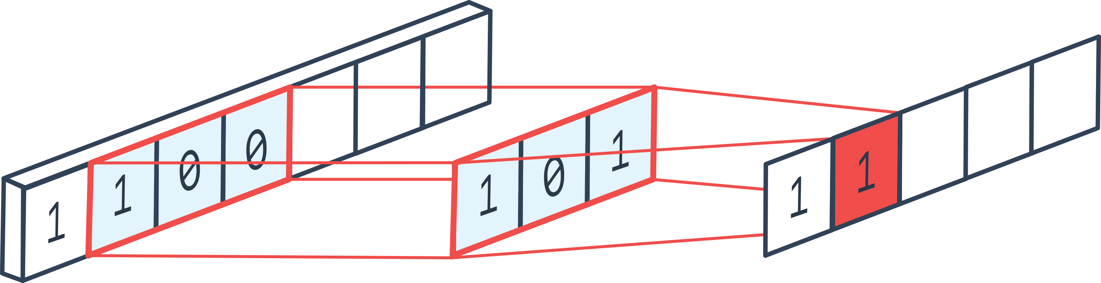
Opportunity Data Sources Methodology Summary & Results​
We experimented with three deep learning models
Fully Connected Neural Network (FCNN)
Convolutional Neural Network (CNN)
25
Notes:
Explain here, so instead of outright calculating the mfcc for each word which is very slow, we trained a Fully connected neural network to estimate them – which is significantly more significant while also preserving accuracy.
Then once we have these MFCCs we move on to the the word classification, but that is a much simpler problem and one that has been solved.

Slide 26
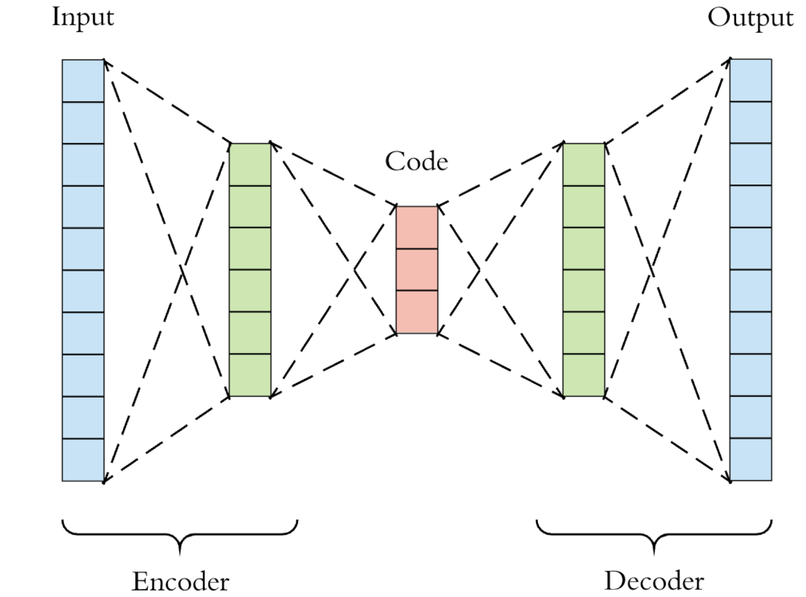
Opportunity Data Sources Methodology Summary & Results​
We experimented with three deep learning models
Fully Connected Neural Network (FCNN)
Convolutional Neural Network (CNN)
Autoencoder (AE)
26
Notes:
Explain here, so instead of outright calculating the mfcc for each word which is very slow, we trained a Fully connected neural network to estimate them – which is significantly more significant while also preserving accuracy.
Then once we have these MFCCs we move on to the the word classification, but that is a much simpler problem and one that has been solved.

Slide 27
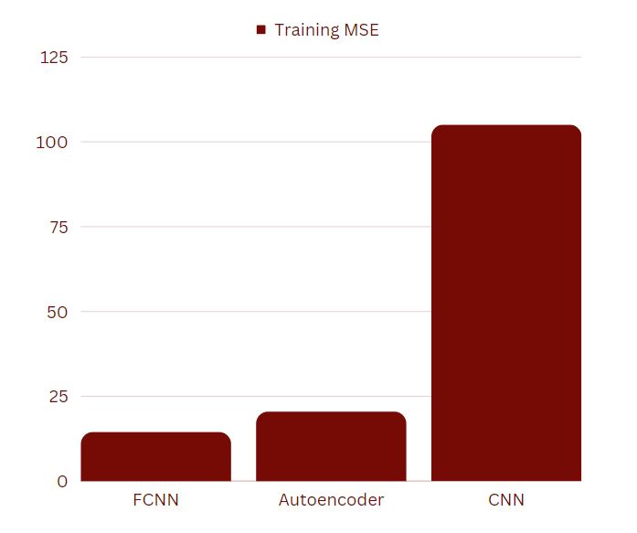
Opportunity Data Sources Methodology Summary & Results​
Fully Connected Neural Network is the best performing MFCC estimator
104.96
20.37
14.35
27
Notes:
Explain here, so instead of outright calculating the mfcc for each word which is very slow, we trained a Fully connected neural network to estimate them – which is significantly more significant while also preserving accuracy.
Then once we have these MFCCs we move on to the the word classification, but that is a much simpler problem and one that has been solved.
-- sort them low to high and make them Bars instead of numbers. Visualize this.
--this is how well part 1 works.

Slide 28
Opportunity Data Sources Methodology Summary & Results​
MFCCs generated from the FCNN give the highest classifier accuracy
Model | Classification Accuracy
Fully Connected Neural Network | 92%
Autoencoder | 81%
Convolutional Neural Network | 80%
28
Notes:
Explain here, so instead of outright calculating the mfcc for each word which is very slow, we trained a Fully connected neural network to estimate them – which is significantly more significant while also preserving accuracy.
Then once we have these MFCCs we move on to the the word classification, but that is a much simpler problem and one that has been solved.
-- sort them low to high and make them Bars instead of numbers. Visualize this.
--this is how well part 1 works.

Slide 29
Opportunity Data Sources Methodology Summary & Results​
We trained a Neural Network to estimate MFCCs instead of calculating them
Fully Connected Neural Network
Estimated
MFCC
Audio Input
29
Notes:
Explain here, so instead of outright calculating the mfcc for each word which is very slow, we trained a Fully connected neural network to estimate them – which is significantly more significant while also preserving accuracy.
Then once we have these MFCCs we move on to the the word classification, but that is a much simpler problem and one that has been solved.

Slide 30
Opportunity Data Sources Methodology Summary & Results​
Then use those MFCCs as input to a CNN to classify them
"Backward"
Estimated
MFCC
Convolutional Neural Network Classifier
30
Notes:
Explain here, so instead of outright calculating the mfcc for each word which is very slow, we trained a Fully connected neural network to estimate them – which is significantly more significant while also preserving accuracy.
Then once we have these MFCCs we move on to the the word classification, but that is a much simpler problem and one that has been solved.

Slide 31
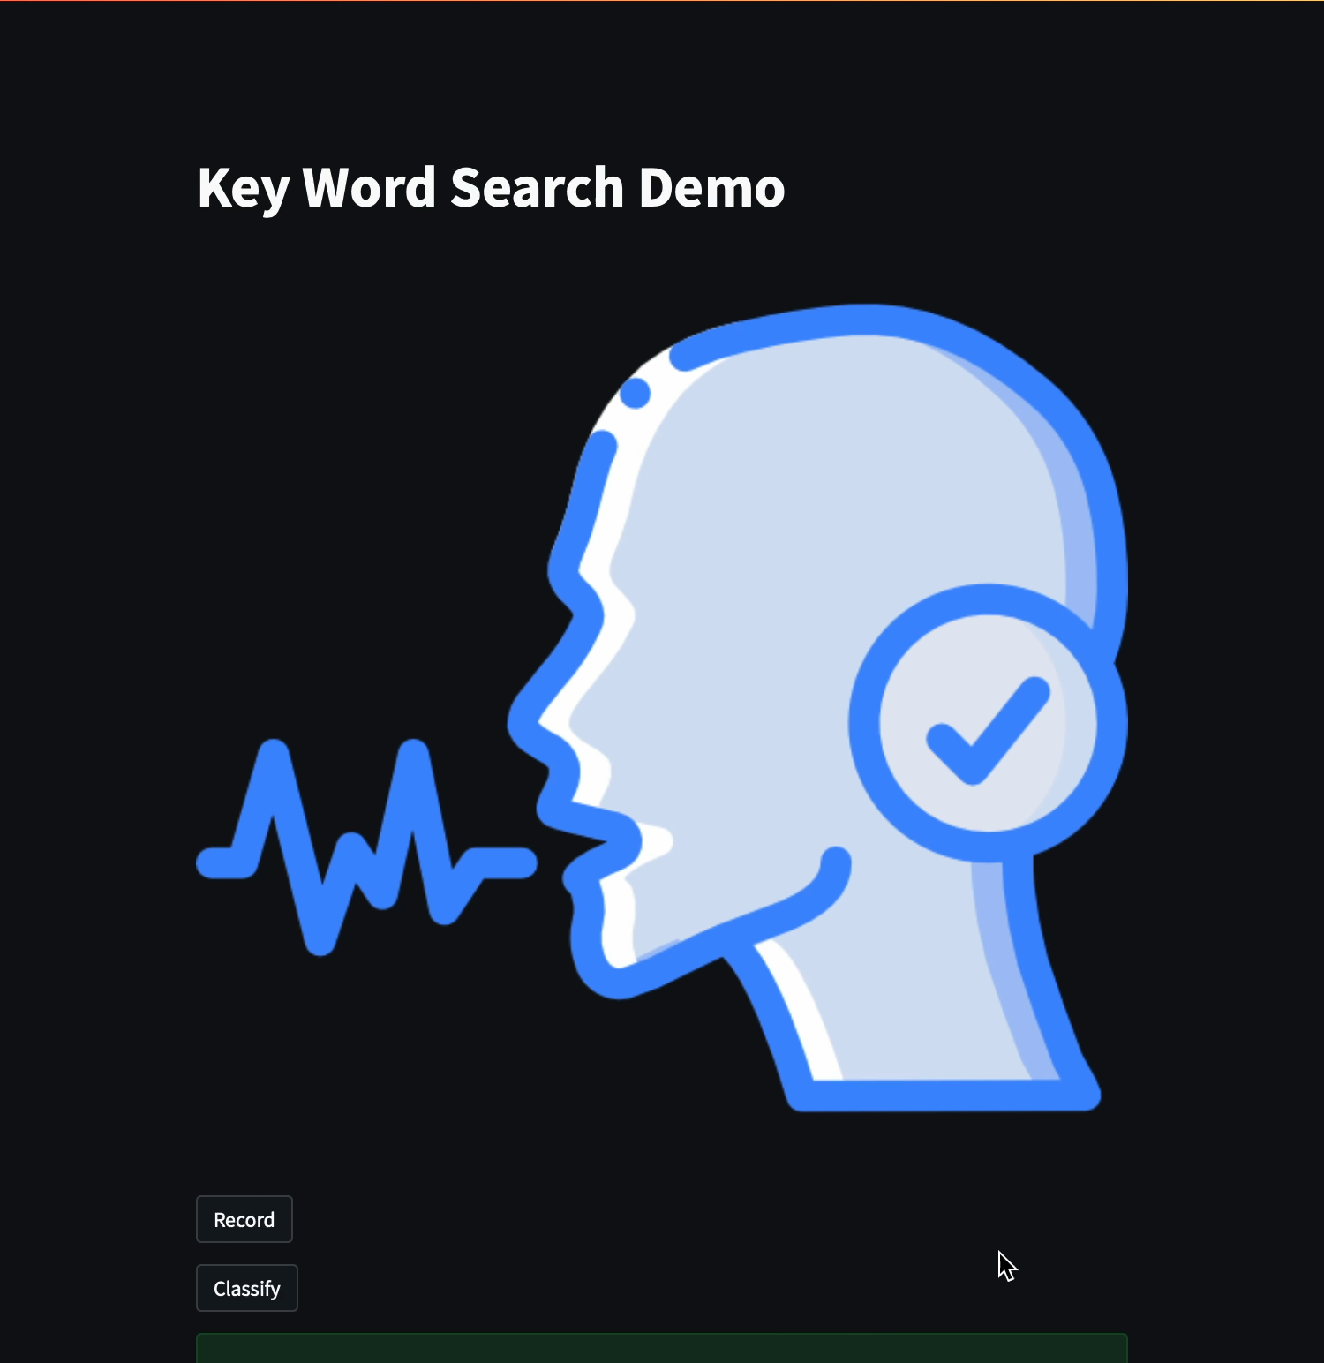
Opportunity Data Sources Methodology Demo & Conclusion​
Demo
31
Notes:
So let's take a look at it". And while we're demoing call back to why it's a big problem and that none of this is being sent to the internet for calculation".
We started with these words and this is a model and we had to test it. and this is where everyone starts with this dataset. but if they can't get the basics, you cant get the complex stuff. But the framework is in place to train any set of words
"This is the way everyone starts.. the industry standard is GSC... sure we don't have the whole dictionary yet...but nobody starts with the whole dictionary... So next steps are that we have PROVED this approach can work, next step it to scale
-- to make this work we have to be accurate, fast and perform within the capabilities of this chipa
--- 55 secs is too long.
-- can we chop it up and demonstrate how it works. Break it up into 2 second pieces. First 10 secs this is what ur gonna see etc.

Slide 32
Opportunity Data Sources Methodology Demo & Conclusion​
Challenges we overcame when building our solution
Learning the complexities of audio preprocessing and speech recognition in ML
32
Notes:
Now wed like to touch on some of the challenges we faced when building our solution
In the program we learned several different aspects of machine learning such as computer vision and natural language processing. However, we did not take a speech/audio recognition . Class or touch on it frequently in other classes. The audio and speech learning required for this project was done entirely through our sponsors at Maxim Integrated and through our own private research.
Additionally with such large audio datasets our local machines did not cut it. We had to research acquire and pay for multiple different cloud computing platforms whether that be from the Midway at uchicago’s RCC, google collab pro subscriptions to Azure virtual machines and machine learning studios. By the end we were all able to have multiple experiments running at once due to the amount of resources we acquired.
Along with such large datasets came the usual 10-20 hour training cycles needed to complete an experiment of the first part of our solution to then be fed into the second with its own multi hour training. Ultimately, Training time management and the documentation of experiments and models were vital hills to overcome for our success.

Slide 33
Opportunity Data Sources Methodology Demo & Conclusion​
Challenges we overcame when building our solution
Learning the complexities of audio preprocessing and speech recognition in ML
Computational requirements and acquiring cloud computing resources
33
Notes:
Now wed like to touch on some of the challenges we faced when building our solution
In the program we learned several different aspects of machine learning such as computer vision and natural language processing. However, we did not take a speech/audio recognition . Class or touch on it frequently in other classes. The audio and speech learning required for this project was done entirely through our sponsors at Maxim Integrated and through our own private research.
Additionally with such large audio datasets our local machines did not cut it. We had to research acquire and pay for multiple different cloud computing platforms whether that be from the Midway at uchicago’s RCC, google collab pro subscriptions to Azure virtual machines and machine learning studios. By the end we were all able to have multiple experiments running at once due to the amount of resources we acquired.
Along with such large datasets came the usual 10-20 hour training cycles needed to complete an experiment of the first part of our solution to then be fed into the second with its own multi hour training. Ultimately, Training time management and the documentation of experiments and models were vital hills to overcome for our success.

Slide 34
Opportunity Data Sources Methodology Demo & Conclusion​
Challenges we overcame when building our solution
Learning the complexities of audio preprocessing and speech recognition in ML
Computational requirements and acquiring cloud computing resources
Multi-hour training cycles
34
Notes:
Now wed like to touch on some of the challenges we faced when building our solution
In the program we learned several different aspects of machine learning such as computer vision and natural language processing. However, we did not take a speech/audio recognition . Class or touch on it frequently in other classes. The audio and speech learning required for this project was done entirely through our sponsors at Maxim Integrated and through our own private research.
Additionally with such large audio datasets our local machines did not cut it. We had to research acquire and pay for multiple different cloud computing platforms whether that be from the Midway at uchicago’s RCC, google collab pro subscriptions to Azure virtual machines and machine learning studios. By the end we were all able to have multiple experiments running at once due to the amount of resources we acquired.
Along with such large datasets came the usual 10-20 hour training cycles needed to complete an experiment of the first part of our solution to then be fed into the second with its own multi hour training. Ultimately, Training time management and the documentation of experiments and models were vital hills to overcome for our success.

Slide 35
Opportunity Data Sources Methodology Demo & Conclusion​
Our solution improves the industry standard method in three ways
Your conversations are now private again
35
Notes:
So let's take a look at it". And while we're demoing call back to why it's a big problem and that none of this is being sent to the internet for calculation".
We started with these words and this is a model and we had to test it. and this is where everyone starts with this dataset. but if they can't get the basics, you cant get the complex stuff. But the framework is in place to train any set of words
"This is the way everyone starts.. the industry standard is GSC... sure we don't have the whole dictionary yet...but nobody starts with the whole dictionary... So next steps are that we have PROVED this approach can work, next step it to scale.
--emphasize first point. BY DOING THIS WE ARE ABLE TO BRING PRIVACY INTO THIS. So heavy emphasis on first point and just drive it home.

Slide 36
Opportunity Data Sources Methodology Demo & Conclusion​
Our solution improves the industry standard method in three ways
Your conversations are now private again
Less latency since wake-up word detection is local
36
Notes:
So let's take a look at it". And while we're demoing call back to why it's a big problem and that none of this is being sent to the internet for calculation".
We started with these words and this is a model and we had to test it. and this is where everyone starts with this dataset. but if they can't get the basics, you cant get the complex stuff. But the framework is in place to train any set of words
"This is the way everyone starts.. the industry standard is GSC... sure we don't have the whole dictionary yet...but nobody starts with the whole dictionary... So next steps are that we have PROVED this approach can work, next step it to scale.
--emphasize first point. BY DOING THIS WE ARE ABLE TO BRING PRIVACY INTO THIS. So heavy emphasis on first point and just drive it home.

Slide 37
Opportunity Data Sources Methodology Demo & Conclusion​
Our solution improves the industry standard method in three ways
Your conversations are now private again
Less latency since wake-up word detection is local
Much less power used by avoiding complex calculations
37
Notes:
So let's take a look at it". And while we're demoing call back to why it's a big problem and that none of this is being sent to the internet for calculation".
We started with these words and this is a model and we had to test it. and this is where everyone starts with this dataset. but if they can't get the basics, you cant get the complex stuff. But the framework is in place to train any set of words
"This is the way everyone starts.. the industry standard is GSC... sure we don't have the whole dictionary yet...but nobody starts with the whole dictionary... So next steps are that we have PROVED this approach can work, next step it to scale.
--emphasize first point. BY DOING THIS WE ARE ABLE TO BRING PRIVACY INTO THIS. So heavy emphasis on first point and just drive it home.

Slide 38
Opportunity Data Sources Methodology Demo & Conclusion​
This framework can be used to expand applicable use cases
Model is proven to work on the entirety of google speech commands, and now can be trained on other words depending on the product’s needs.
38

Slide 39
Opportunity Data Sources Methodology Demo & Conclusion​
This framework can be used to expand applicable use cases
Model is proven to work on the entirety of google speech commands, and now can be trained on other words depending on the product’s needs.
Once the MAX78000 is in production it will be the most efficient microchip on the market that does not upload your data over the internet.
39

Slide 40
Thank you.
Special thanks to…
Don Patchell
Gizem Aydin, PhD
Prominence Advisors: Batuhan Gundogdu & Gorkem Ulkar
Notes:
Play up energy savings / privacy component more to drive home. How much does It have to do between hardware and software component.
Appendix slide on MFCCS.
WHY does it have to be MFCCs
-explain MFCCA log transformation

Slide 41
Appendix

Slide 42
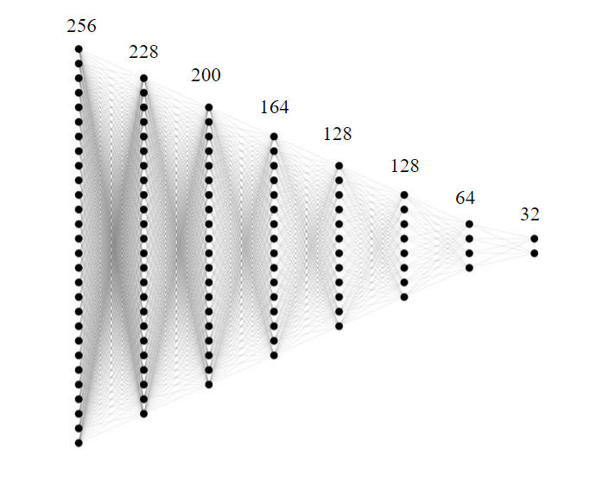
Opportunity Data Sources Methodology Summary & Results​
Our current top performing fully-connected NN shows the lowest MSE
12

Slide 43
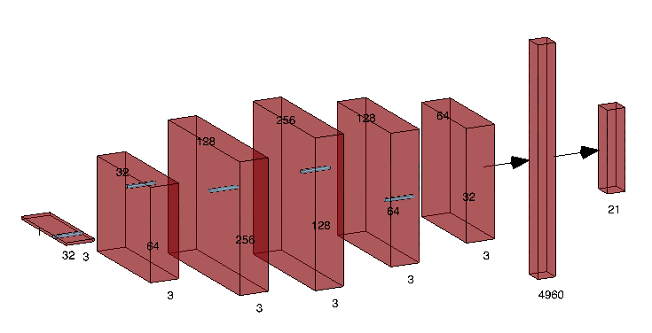
Opportunity Data Sources Methodology Summary & Results​
Our best performing CNN architecture classifies at 92%
13

Slide 44
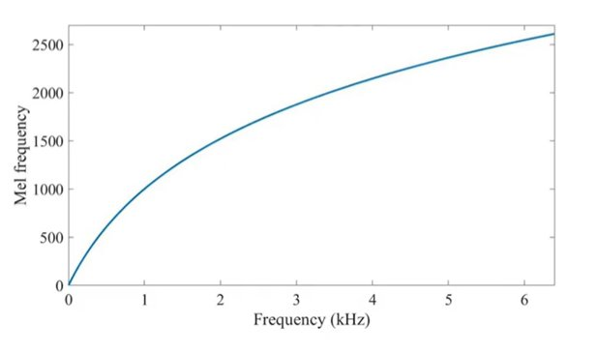

Opportunity Data Sources Methodology Summary & Results​
Why MFCCs?
Humans Perceive Frequency Logarithmically, not linearly
We apply Mel-Scaling because it is analogous to human hearing. And thus, better suited for audio classification
Example:
C2-C4 (65 - 262Hz)
G6-A6 (1568 - 1960hz)
44
Notes:
There are 2 major parts for speech recognition. The first part, in which a series of computationally heavy transformations take place, is what our solution replaces. The 2nd part of the process remains the same. This is a simple overview of how the industry standard process takes raw audio and converts it into an audio feature.

Slide 45
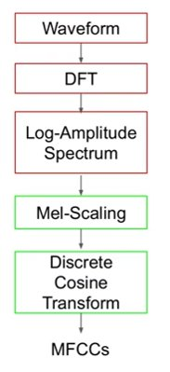
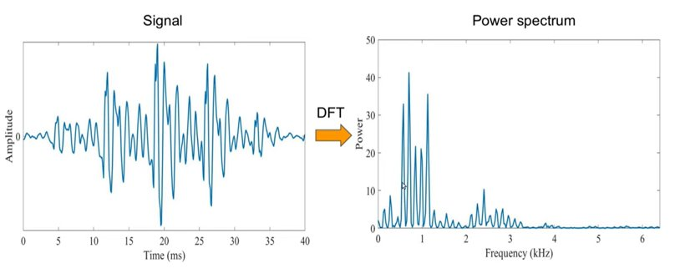

Opportunity Data Sources Methodology Summary & Results​
MFCC Calculation: Step 1
45
Notes:
There are 2 major parts for speech recognition. The first part, in which a series of computationally heavy transformations take place, is what our solution replaces. The 2nd part of the process remains the same. This is a simple overview of how the industry standard process takes raw audio and converts it into an audio feature.

Slide 46
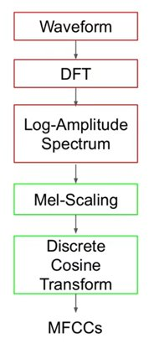
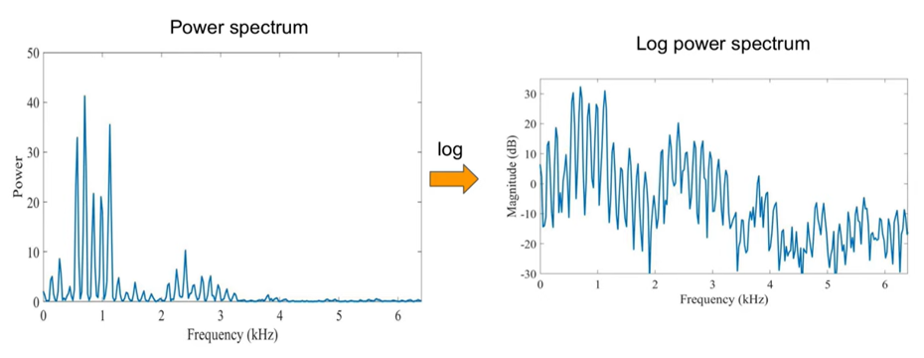

Opportunity Data Sources Methodology Summary & Results​
MFCC Calculation: Step 2
46
Notes:
There are 2 major parts for speech recognition. The first part, in which a series of computationally heavy transformations take place, is what our solution replaces. The 2nd part of the process remains the same. This is a simple overview of how the industry standard process takes raw audio and converts it into an audio feature.

Slide 47
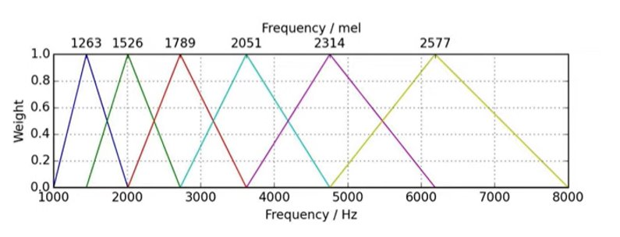

Opportunity Data Sources Methodology Summary & Results​
MFCC Calculation: Step 3
47
Notes:
There are 2 major parts for speech recognition. The first part, in which a series of computationally heavy transformations take place, is what our solution replaces. The 2nd part of the process remains the same. This is a simple overview of how the industry standard process takes raw audio and converts it into an audio feature.

Slide 48
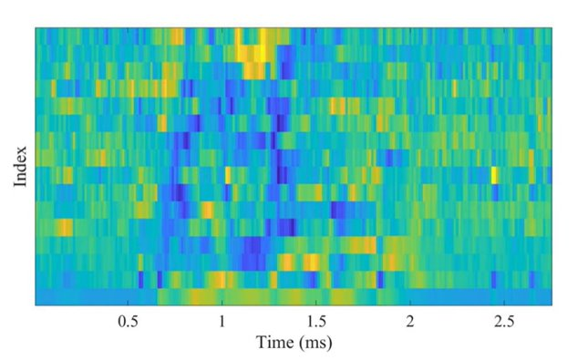

Opportunity Data Sources Methodology Summary & Results​
Our entire process is over 44x more efficient than state-of-the-art
48
Notes:
There are 2 major parts for speech recognition. The first part, in which a series of computationally heavy transformations take place, is what our solution replaces. The 2nd part of the process remains the same. This is a simple overview of how the industry standard process takes raw audio and converts it into an audio feature.

Slide 49
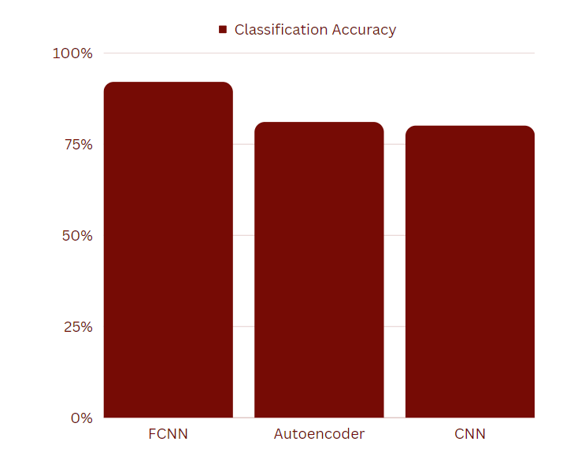
Opportunity Data Sources Methodology Summary & Results​
MFCCs generated from the FCNN give the highest classifier accuracy
49
Notes:
Explain here, so instead of outright calculating the mfcc for each word which is very slow, we trained a Fully connected neural network to estimate them – which is significantly more significant while also preserving accuracy.
Then once we have these MFCCs we move on to the the word classification, but that is a much simpler problem and one that has been solved.
-- sort them low to high and make them Bars instead of numbers. Visualize this.
--this is how well part 1 works.

Slide 50
Opportunity Data Sources Methodology Summary & Results​
Fully connected neural network is the best performing MFCC estimator
Model | Training MSE
Fully Connected Neural Network | 14.35
Autoencoder | 20.37
Convolutional Neural Network | 104.96
50
Notes:
Explain here, so instead of outright calculating the mfcc for each word which is very slow, we trained a Fully connected neural network to estimate them – which is significantly more significant while also preserving accuracy.
Then once we have these MFCCs we move on to the the word classification, but that is a much simpler problem and one that has been solved.
-- sort them low to high and make them Bars instead of numbers. Visualize this.
--this is how well part 1 works.

Slide 51
Opportunity Resources Methodology Demo & Conclusion​
We have achieved 92% accuracy on 20 words and a rejection class
Fully-connected MFCC estimator
Convolutional Neutral Network
Estimated MFCC
Audio
"Backward"
51
Notes:
And we were able to find a solution for this. Using this framework, which we will dive into later,. we achieved 92% accuracy on a set of 20 words and a 15 word rejection class.

Slide 52
Opportunity Resources Methodology Demo & Conclusion​
We have achieved 92% accuracy on 20 words and a rejection class
Estimated
MFCC
92% accuracy on twenty words
Fully-connected MFCC estimator
Convolutional Neutral Network Classifier
52
Notes:
And we were able to find a solution for this. Using this framework, which we will dive into later,. we achieved 92% accuracy on a set of 20 words and a 15 word rejection class.
**this is problem we solved, but the solution requires another piece… insert this between 9 and 10
***consider removing rejection class. If you include it then you must explain it.

Slide 53
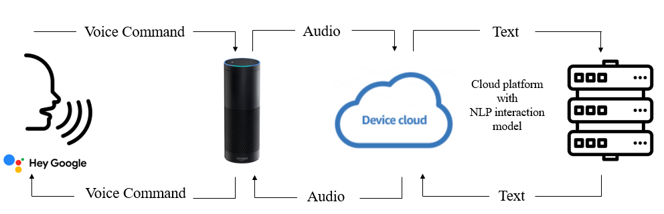
Opportunity Data Sources Methodology Summary & Results​
MAX78000 enables maximum privacy speech compared to competitors
Amazon Alexa:
53
Notes:
You might be thinking, Alexa, siri, cortana, or any smart speaker already does that. You can ask it anything imaginable and it has a response. And you’re right, it does.
But the way that these smart devices work is: *display diagram above* they upload your voice audio to cloud servers and perform the NLP.They are always listening. The benefit of this is that it’s very powerful, but the cons are that, whaterver company manufactured that device now has your vocal data and it’s being uploaded to the internet. There are natural privacy concerns with this, and there. And Sending audio to the cloud also means increased latency
So for privacy it would be huge for people to have pretrained words on these edge devices. And have an Edge device will not send your voice to other places

Slide 54
Opportunity Data Sources Methodology Summary & Results​
Our entire process is over 44x more efficient than state-of-the-art
Device
Latency (ms/inf)
Energy (uJ/inf)
MAX78000
3.5
251
ARM Cortex M4F
905
11200
54
Notes:
There are 2 major parts for speech recognition. The first part, in which a series of computationally heavy transformations take place, is what our solution replaces. The 2nd part of the process remains the same. This is a simple overview of how the industry standard process takes raw audio and converts it into an audio feature.

